Slide 1
Receipt & Invoice Digitizer
By: Shivangi Bhargava

Slide 2
Problem Statement Overview
Businesses and individuals handle numerous paper receipts and invoices, which are prone to loss, errors, and manual entry delays.
We built automated system for scanning, extracting and digitizing information from receipts and invoices using OCR.

Slide 3
Core Components
Frontend: Uses Streamlit to create a web-based dashboard with tabs for uploading receipts and viewing analytics.
API: Leverages Google Gemini Flash, a fast AI model that reads images and extracts itemised details into JSON.
Database: A SQLite database acts as a persistent vault, storing merchant names, dates, and costs indefinitely.

Slide 4
Database Structure
Uses sqlite3 to create a table called receipts.
It stores:
▪Merchant Name & Date of Purchase
▪Total Cost & Currency Type
▪Raw JSON: A detailed list of every item bought.
This allows the app to remember your spending even after you close the browser

Slide 5
Image Preprocessing
We used following to "clean" the receipt:
Grayscale: Removes unnecessary colors.
Denoising: Clears graininess.
Thresholding: Makes text black and white.
This results in much higher extraction success rates.

Slide 6
AI Extraction: Gemini API
The core intelligence is the analyze_receipt() function.
It sends the cleaned image to Google's AI with a specific prompt.
The AI is instructed to "Extract receipt details into JSON."
By specifying a format, we ensure the computer can read the AI's response without errors

Slide 7
Instructing the AI
We use a structured text prompt to tell the AI exactly what we want. This prevents the AI from "chatting" and forces it to just give us the data. Strict Output: The prompt ends with "Return ONLY JSON.”
JSON is like a digital checklist. It defines labels like "merchant" and "total". This makes it easy for our Python code to save the data directly into our SQLite database.

Slide 8
User Interface
Multi-Format Upload: Supports JPG, PNG, and even multi-page PDFs.
Side-by-Side View: Users see the original image vs the "cleaned" AI version.
History Vault: A persistent table that lets users select a specific receipt to see its individual line items.
Analytics dashboard: Includes filters, charts and graph.

Slide 9
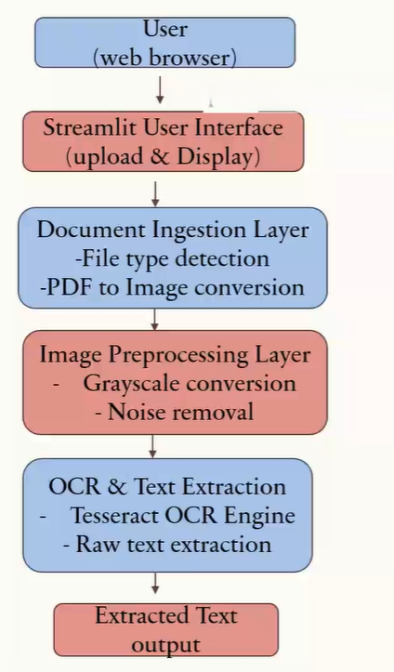
System Architecture Diagram

Slide 10
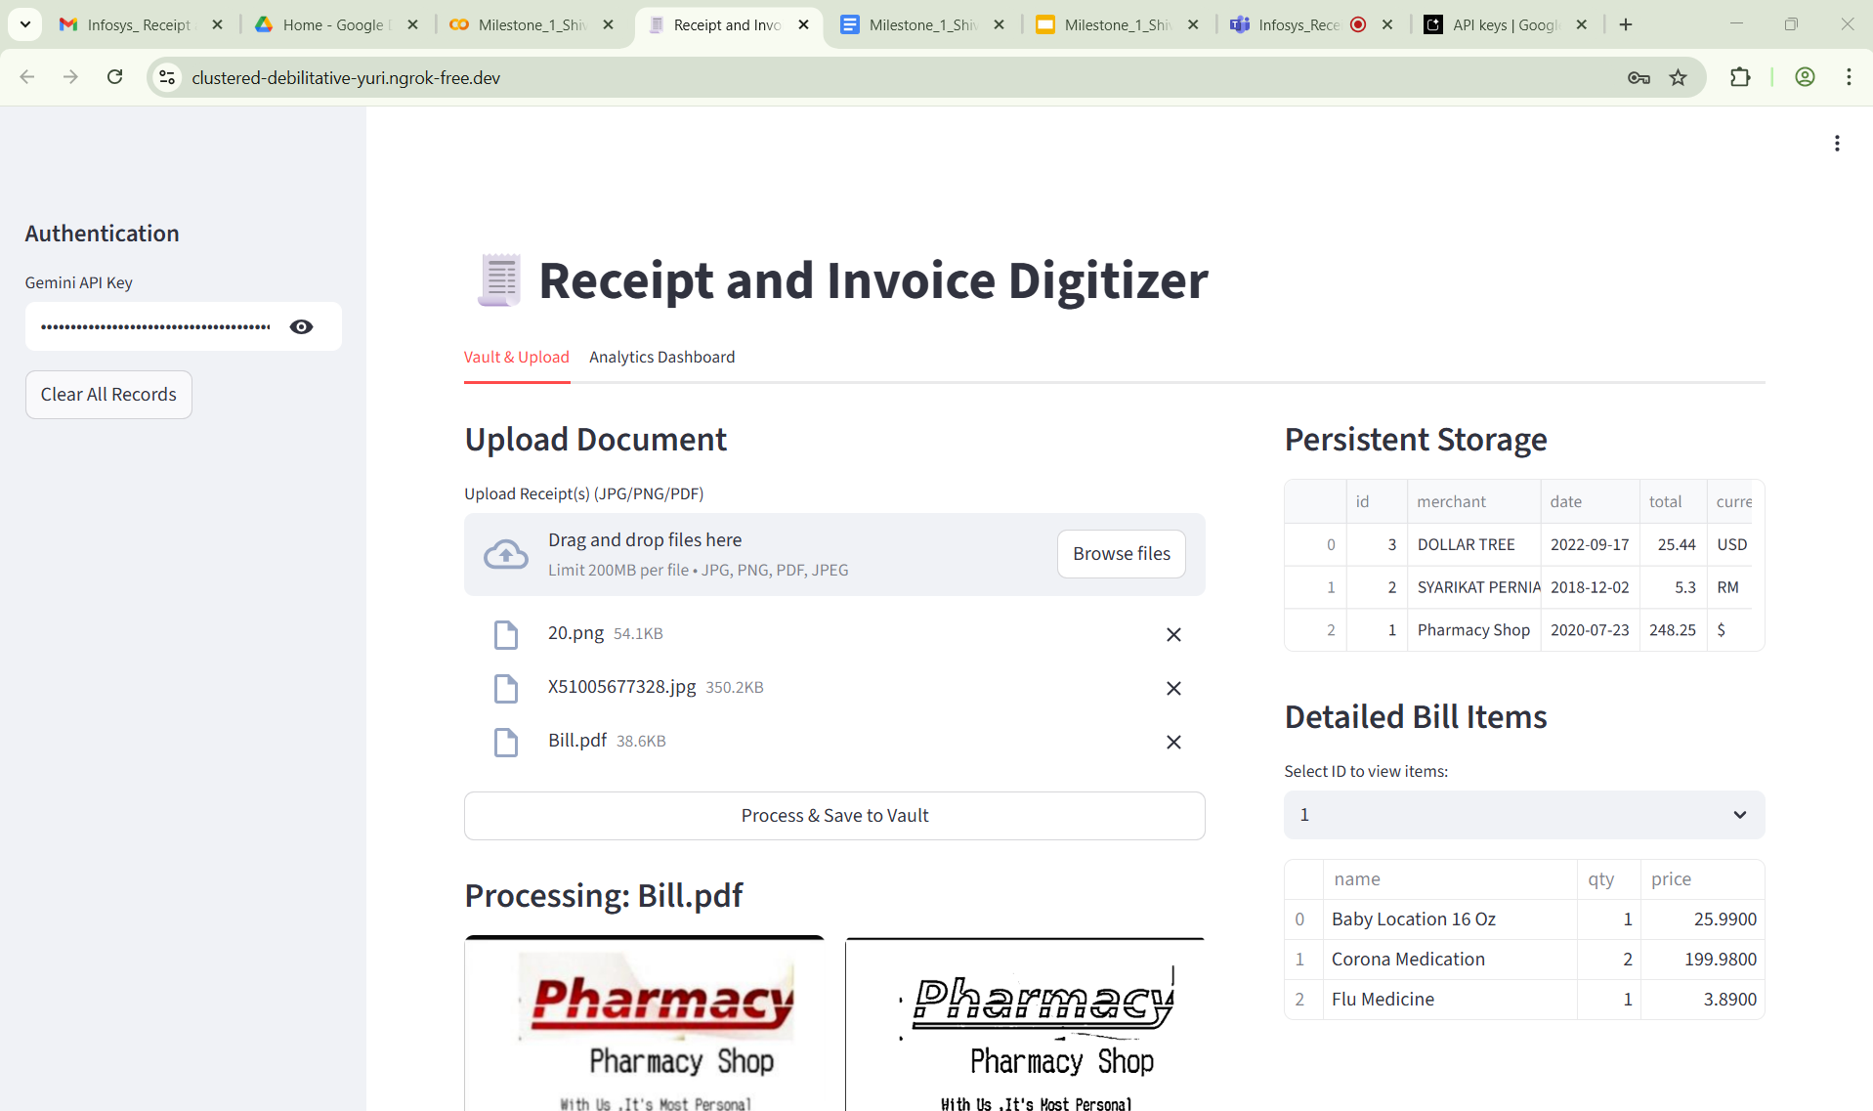
Screenshots

Slide 11
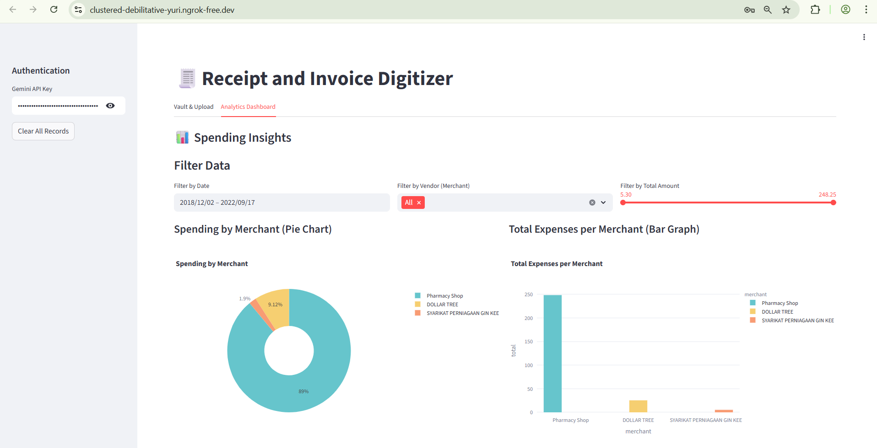
Screenshots

Slide 12
Implemented Modules
Milestone 1:
Document Ingestion & OCR
Implement file upload.
Preprocess images for OCR.
Extract raw text from sample receipts.

Slide 13
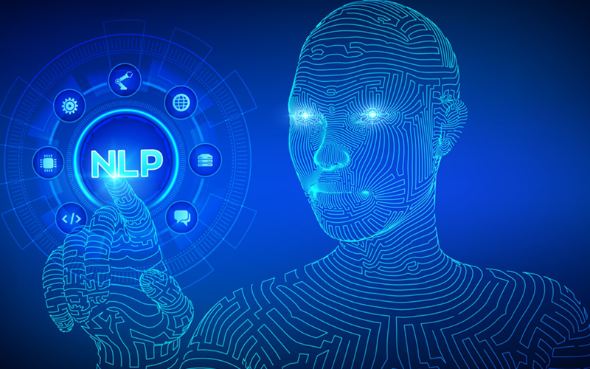
Milestone 2 - Implemented Modules
• Apply regex + NLP to parse key fields.
• Validate totals and detect duplicates.
• Store structured results in DB.

Slide 14

Field Extraction & Validation
• NLP/Regex-based extraction for date, vendor, invoice ID, tax, total amount, line items.
• Validate extracted totals (subtotal + tax = total).
• Detect duplicates via invoice number or hash.

Slide 15
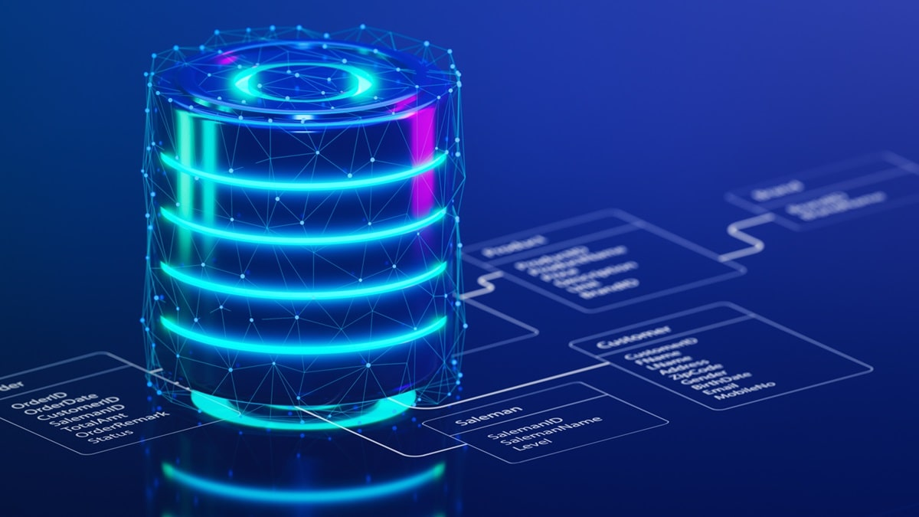
Database Storage
• Store structured invoice/receipt data in SQL database.
• Support search by vendor, date, or amount.

Slide 16
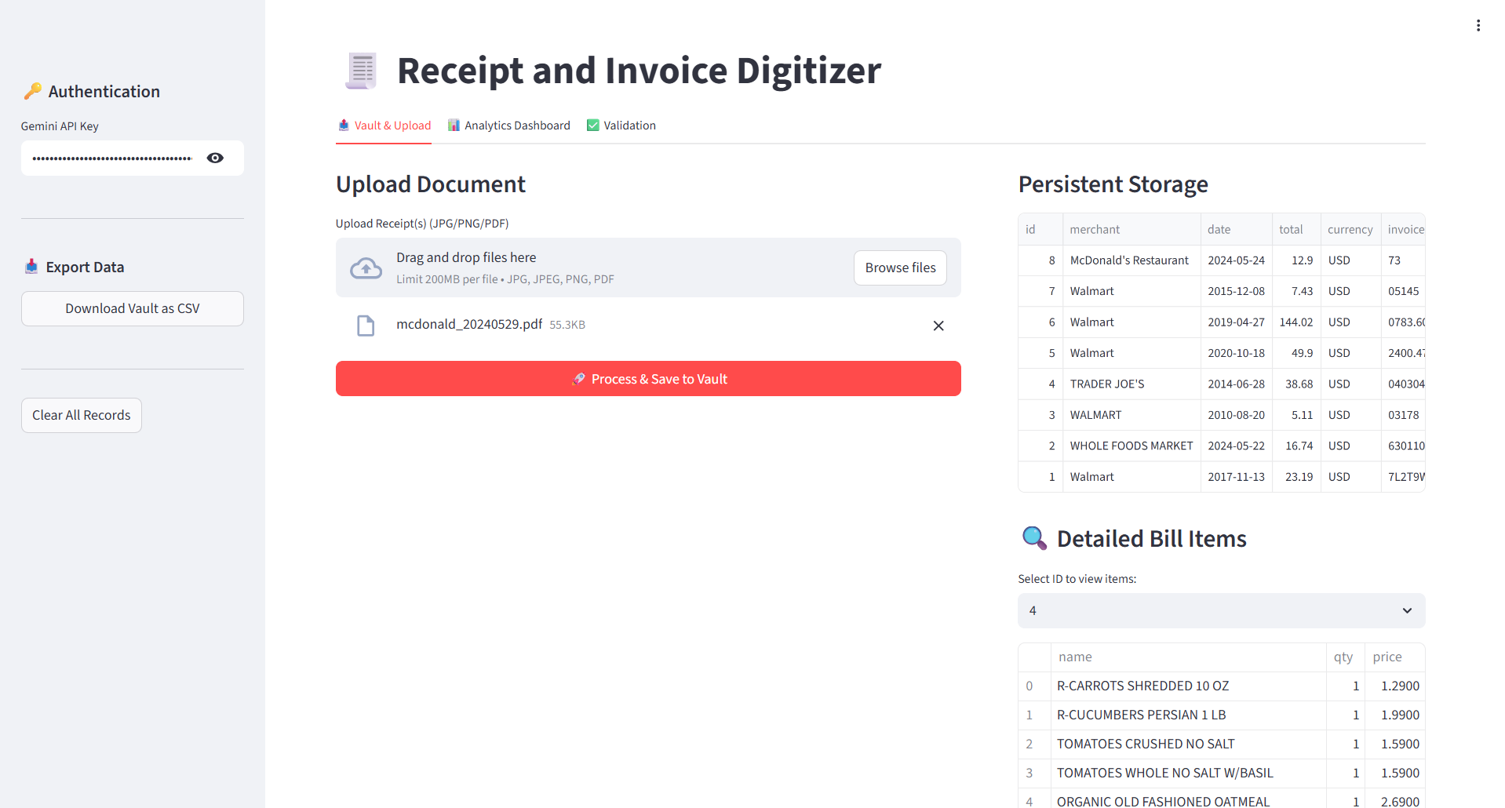
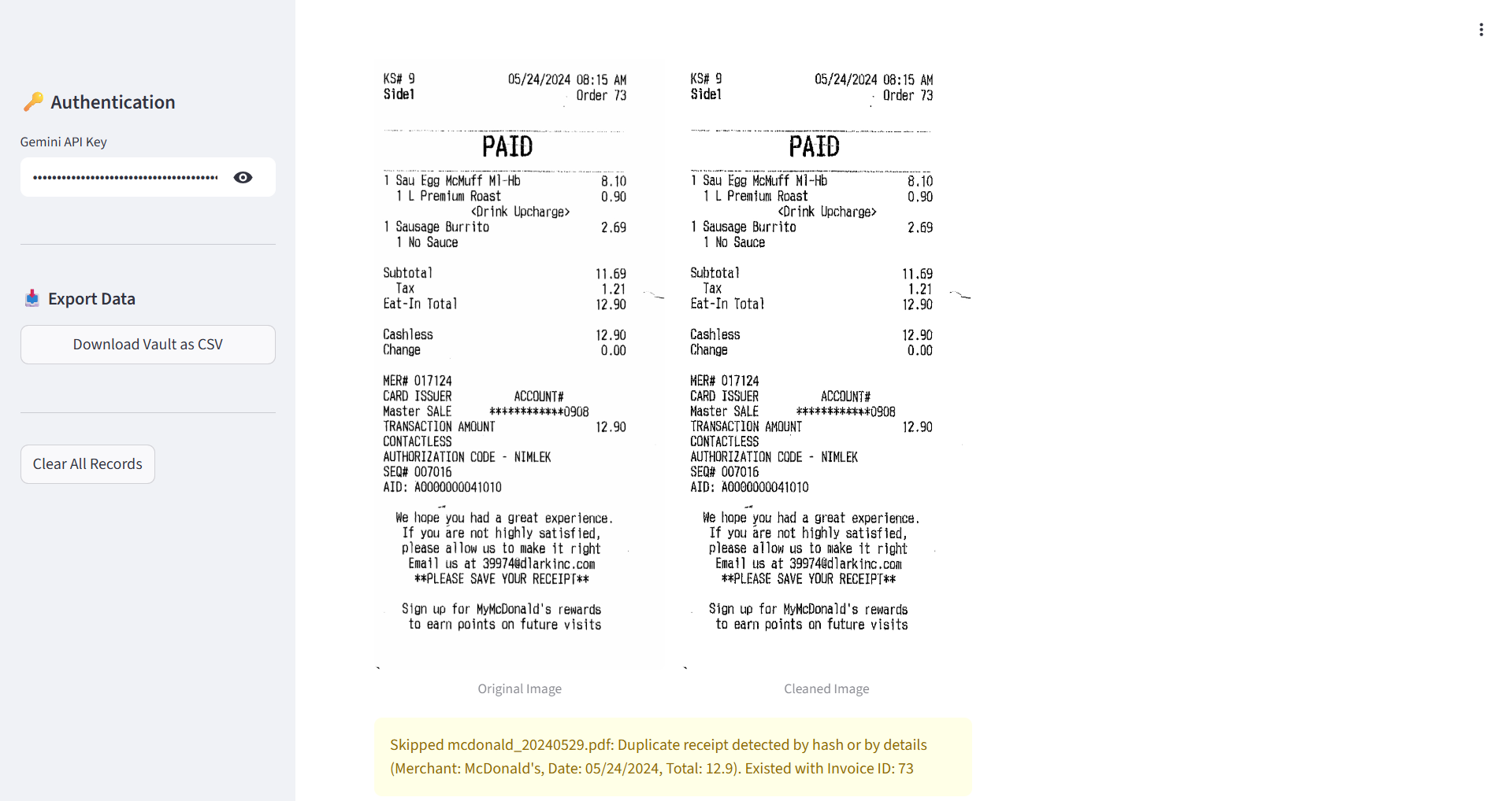
Screenshot : Tab 1

Slide 17
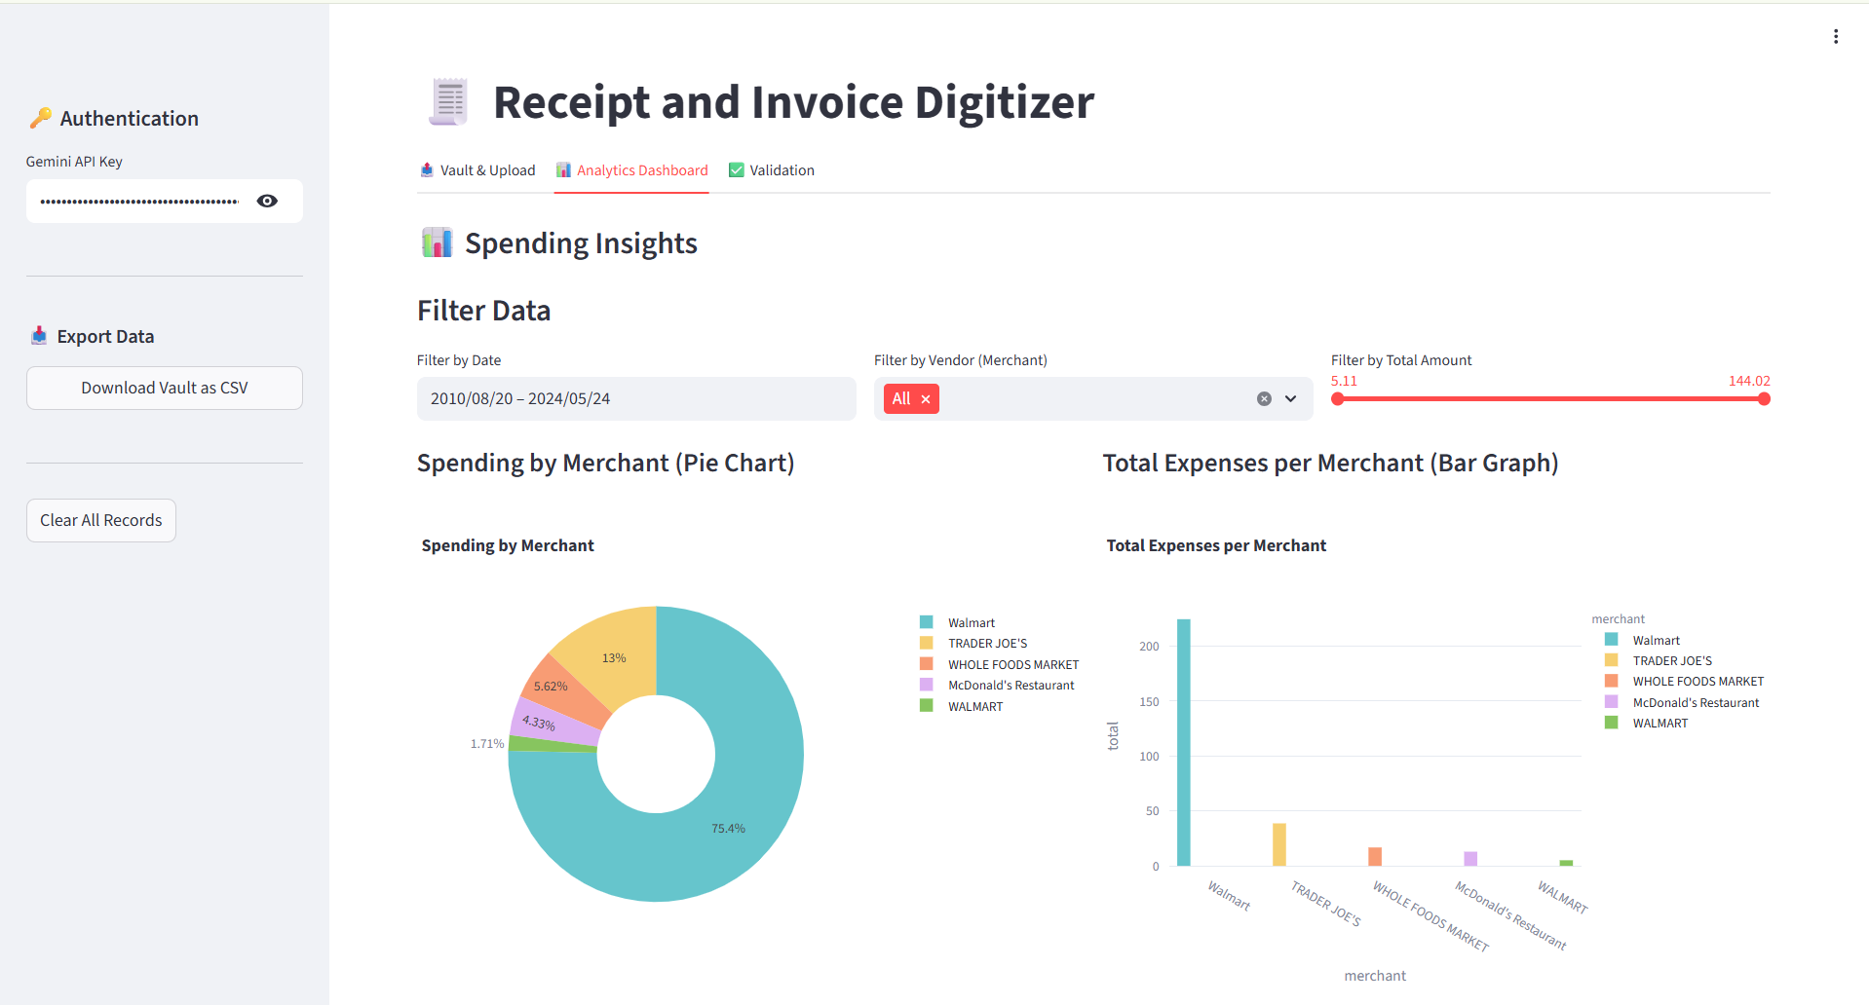
Screenshot : Tab 2

Slide 18
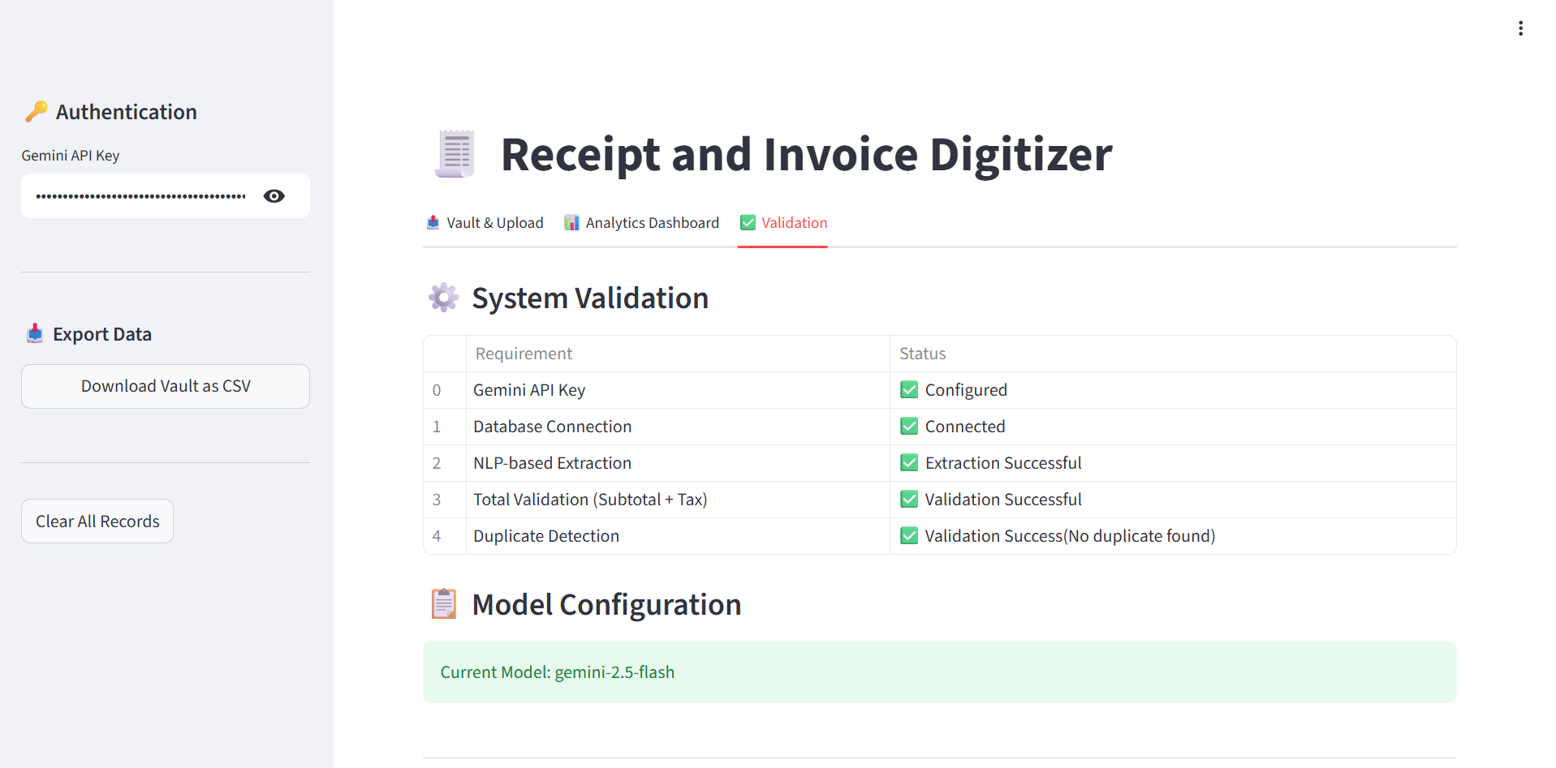
Screenshot : Tab 3

Slide 19
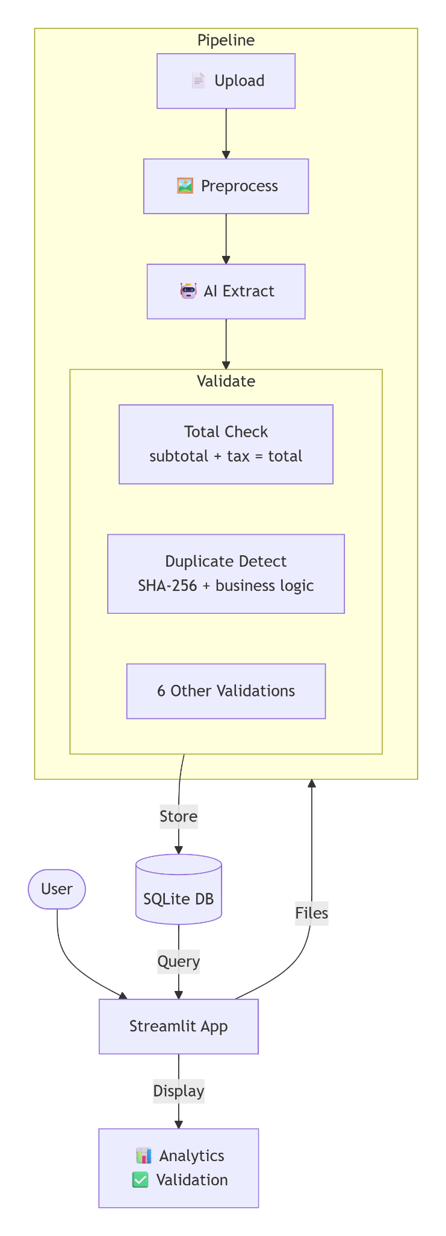
System Architecture Diagram

